Slide 1
Title: DC Metro Crime Data Analysis Subtitle: Analysis of Crime Data from the DC Metro Area
Feyintola Lasekan july 8th 2024

Slide 2
Introduction
This report analyzes crime data from the DC Metro area, specifically focusing
on the dataset dc crime add vars.csv. The dataset contains information on
various crime incidents, including details such as report date, shift, offense type,
location, and additional variables

Slide 3
Data Description
The dataset comprises 32 columns and multiple rows, with each row representing a unique crime incident. Some of the key columns include the report date and time (REPORT_DAT), the shift during which the crime occurred (SHIFT), the type of offense (OFFENSE), the method used (METHOD), and the block where the crime took place (BLOCK). Additionally, geographic identifiers such as district (DISTRICT), PSA (PSA), and ward (WARD) are included, along with temporal details like year, month, day, hour, minute, and second. Directional and quadrant information (EW, NS, quad), as well as crime type categorization (crimetype), are also provided.

Slide 4
Data Quality
An assessment of the dataset reveals several columns with missing values. For instance, the DISTRICT column has 200 missing values, the PSA column has 251 missing values, and the NEIGHBORHOOD_CLUSTER column has 4705 missing values. Other columns, such as BLOCK_GROUP and CENSUS_TRACT, each have 1091 missing values. The VOTING_PRECINCT column has 84 missing values, while the START_DATE and END_DATE columns have 13 and 11651 missing values, respectively. Addressing these missing values is crucial for a more comprehensive analysis.
Initial Findings
Preliminary analysis indicates that the majority of crimes recorded in the dataset are non-violent. The distribution of crimes across different shifts—such as evening, midnight, and day shifts—provides valuable insights into when crimes are more likely to occur. Understanding these temporal patterns can help in planning and implementing effective crime prevention strategies.

Slide 5
Python Code for Analysis
The analysis was conducted using Python, leveraging several powerful libraries for data processing and modeling. The code begins by importing necessary libraries such as numpy for linear algebra and pandas for data processing. The code then lists all files in the input directory to confirm the dataset's presence. After loading the dataset using pd.read_csv(), the first few rows of the dataset are displayed to understand its structure. Missing values in the dataset are then checked, and only numerical columns are selected for further analysis. The target variable and features are defined, and the data is split into training and testing sets. A Linear Regression model is instantiated and fitted on the training data. Predictions are made on the testing data, and the Mean Squared Error (MSE) is calculated to evaluate the model's performance. Finally, the model's coefficients and intercept are printed for further interpretation.

Slide 6
Explanation of Python Code
The Python code for this analysis performs several key steps. First, it loads the necessary libraries for data processing, model building, and evaluation. It then lists all files in the input directory to ensure the dataset is available. The dataset is loaded using pandas.read_csv(), and the first few rows are displayed to understand the data's structure. The code checks for any missing values in the dataset and selects only numerical columns for the analysis. The target variable and features are defined, and the data is split into training and testing sets using the train_test_split function from sklearn. A Linear Regression model is instantiated and fitted on the training data. Predictions are made on the test data, and the Mean Squared Error (MSE) is calculated to evaluate the model's performance. The model's coefficients and intercept are printed for further analysis and interpretation.

Slide 7
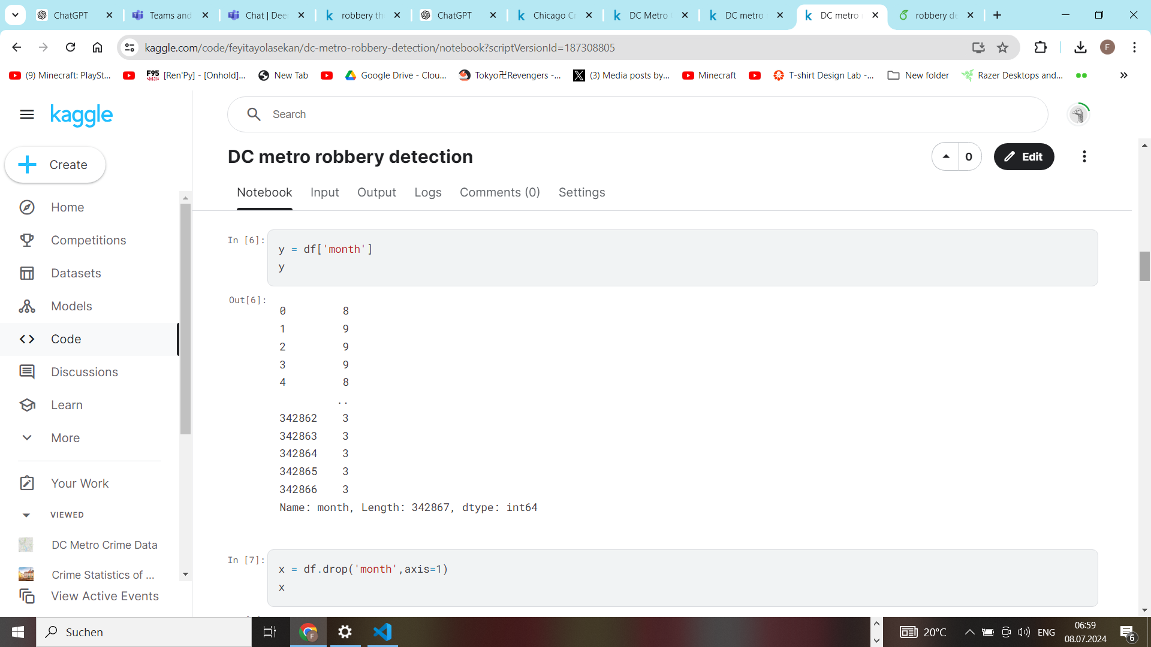
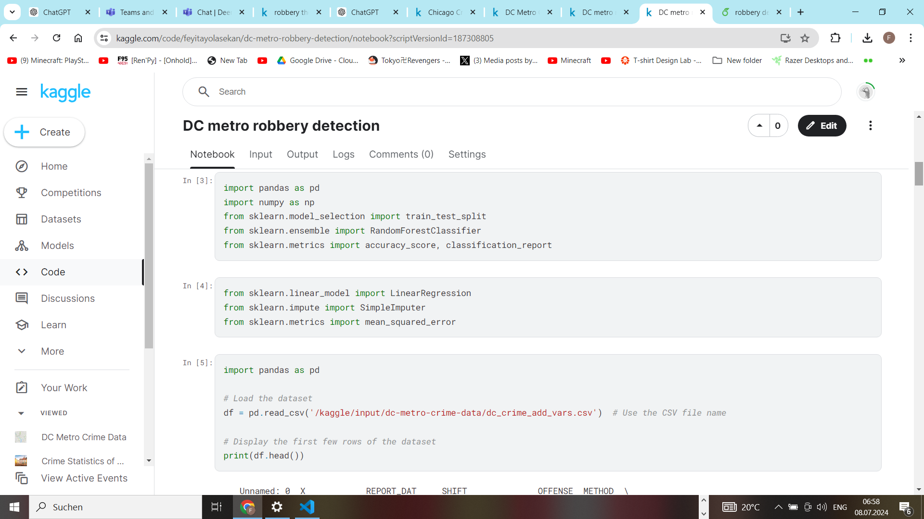
the code

Slide 8
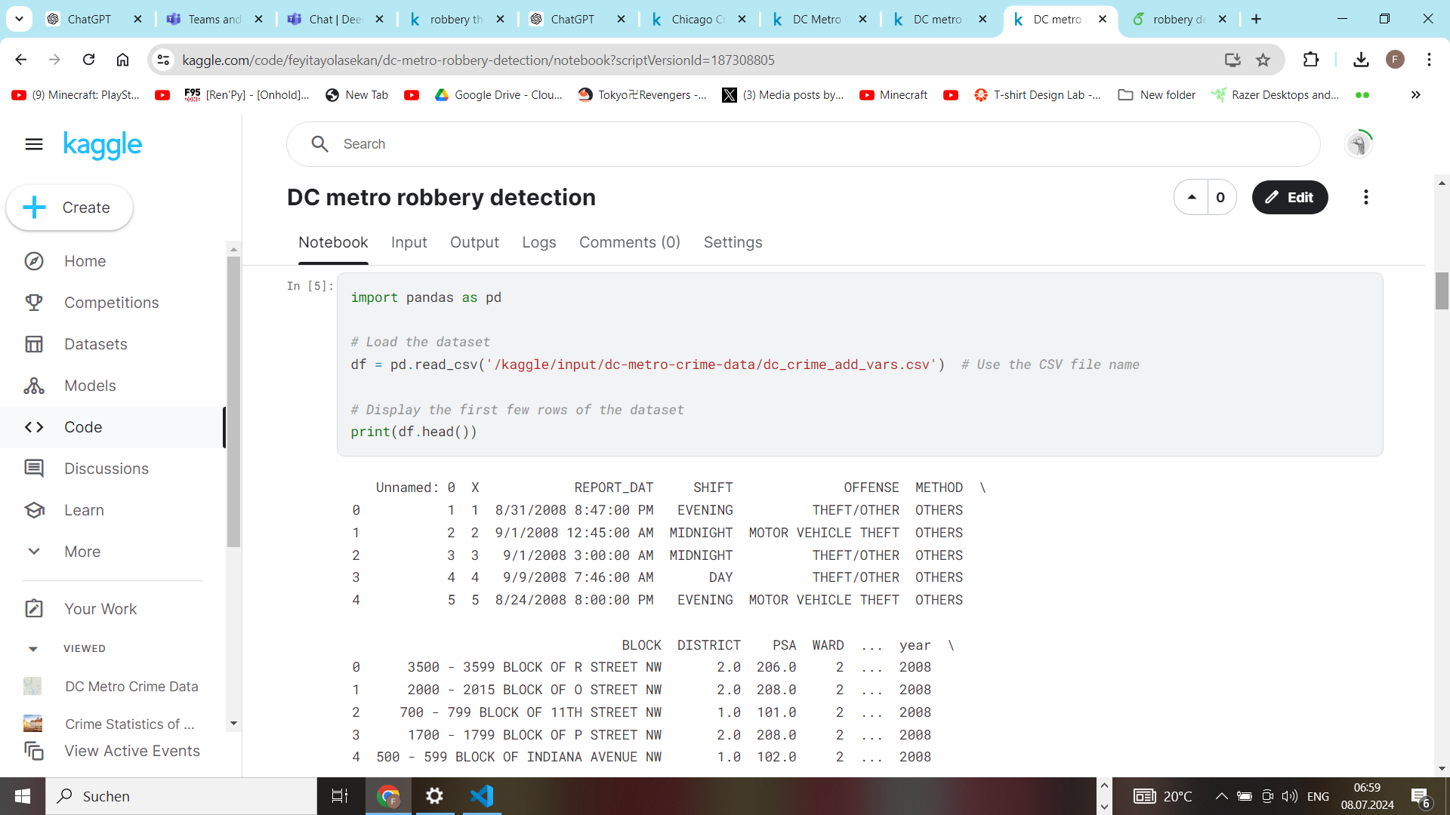
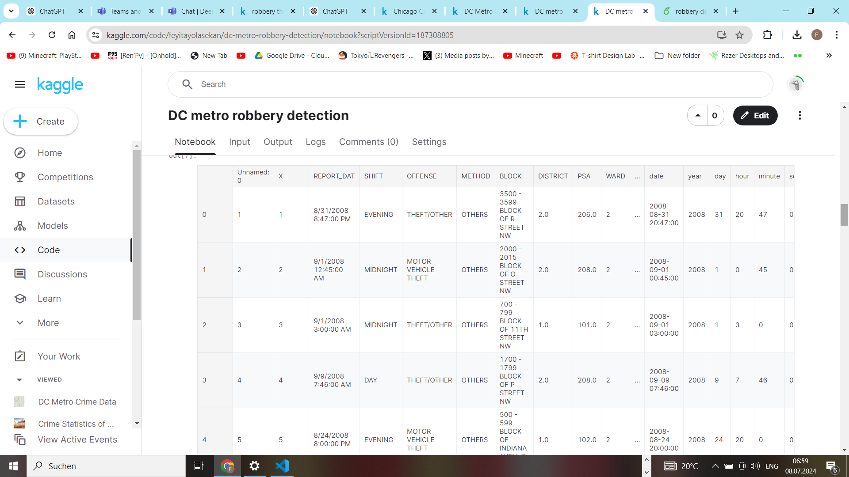

Slide 9
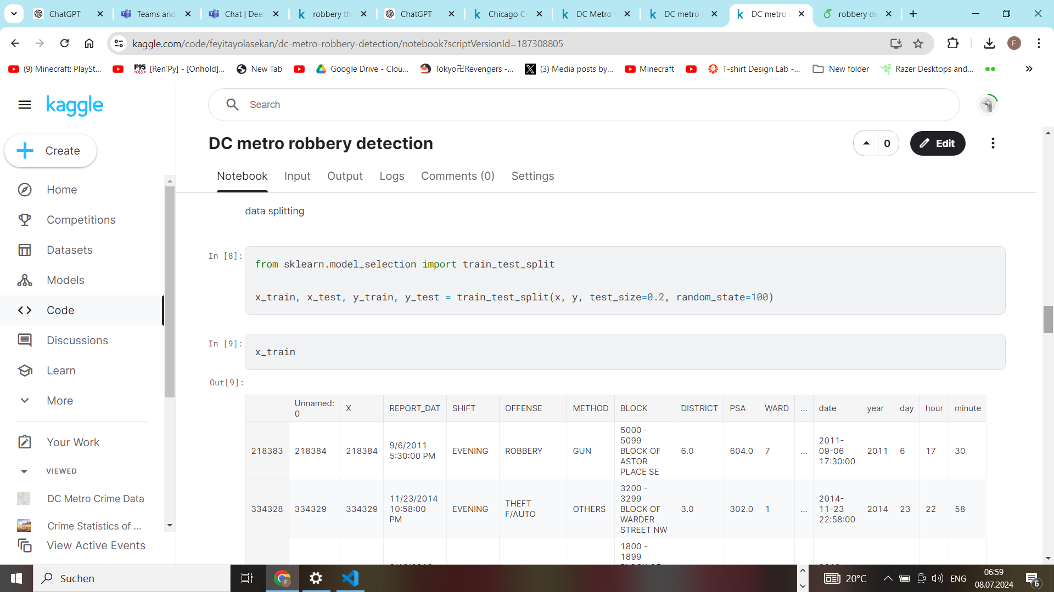
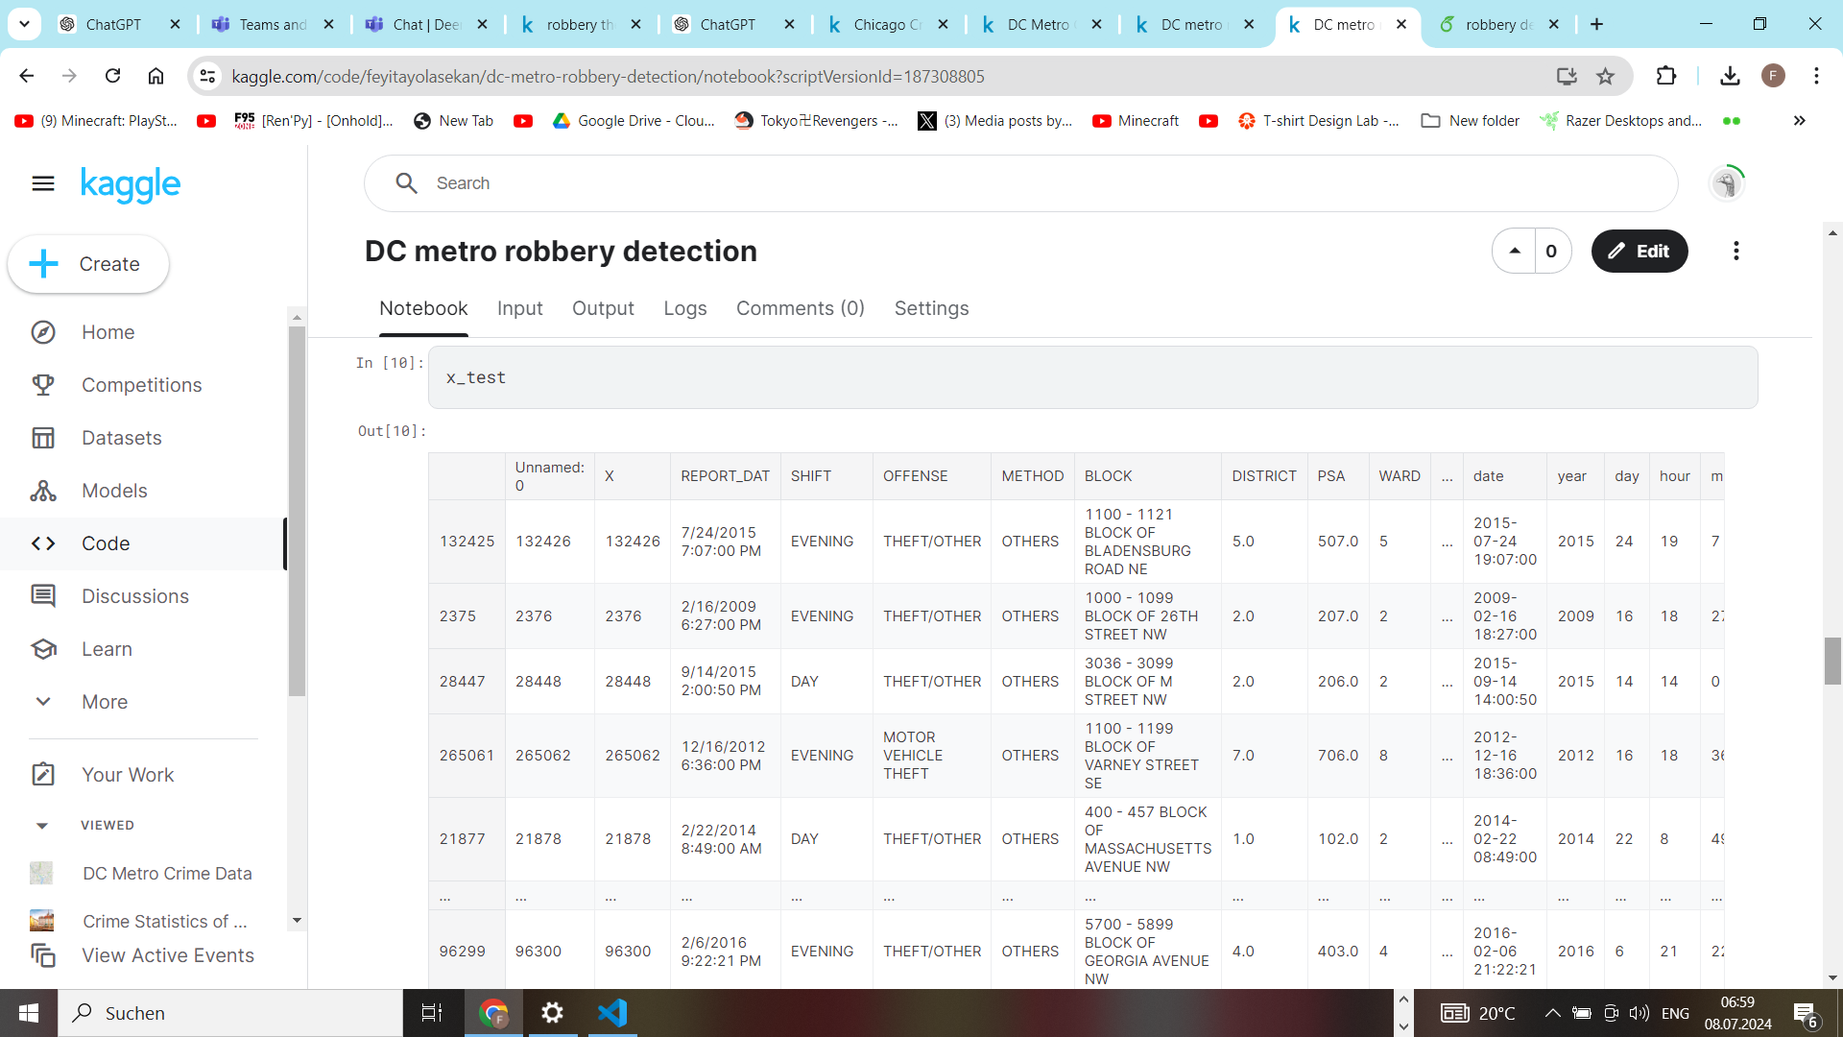

Slide 10
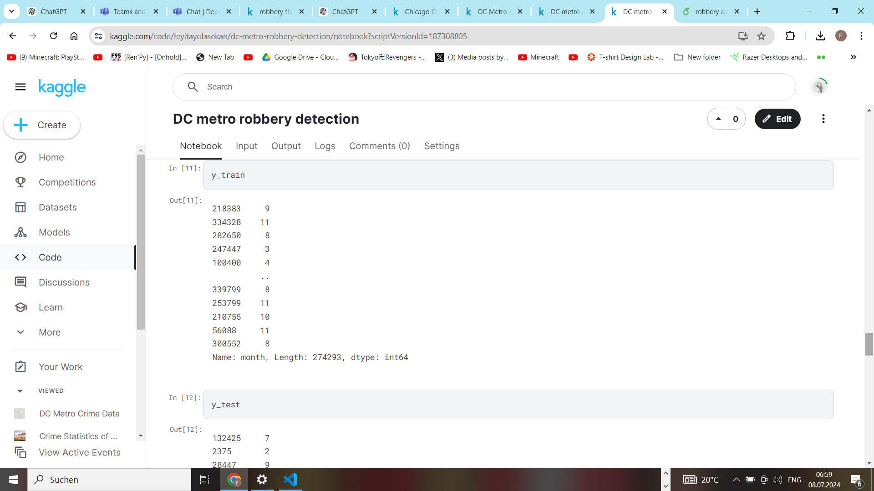
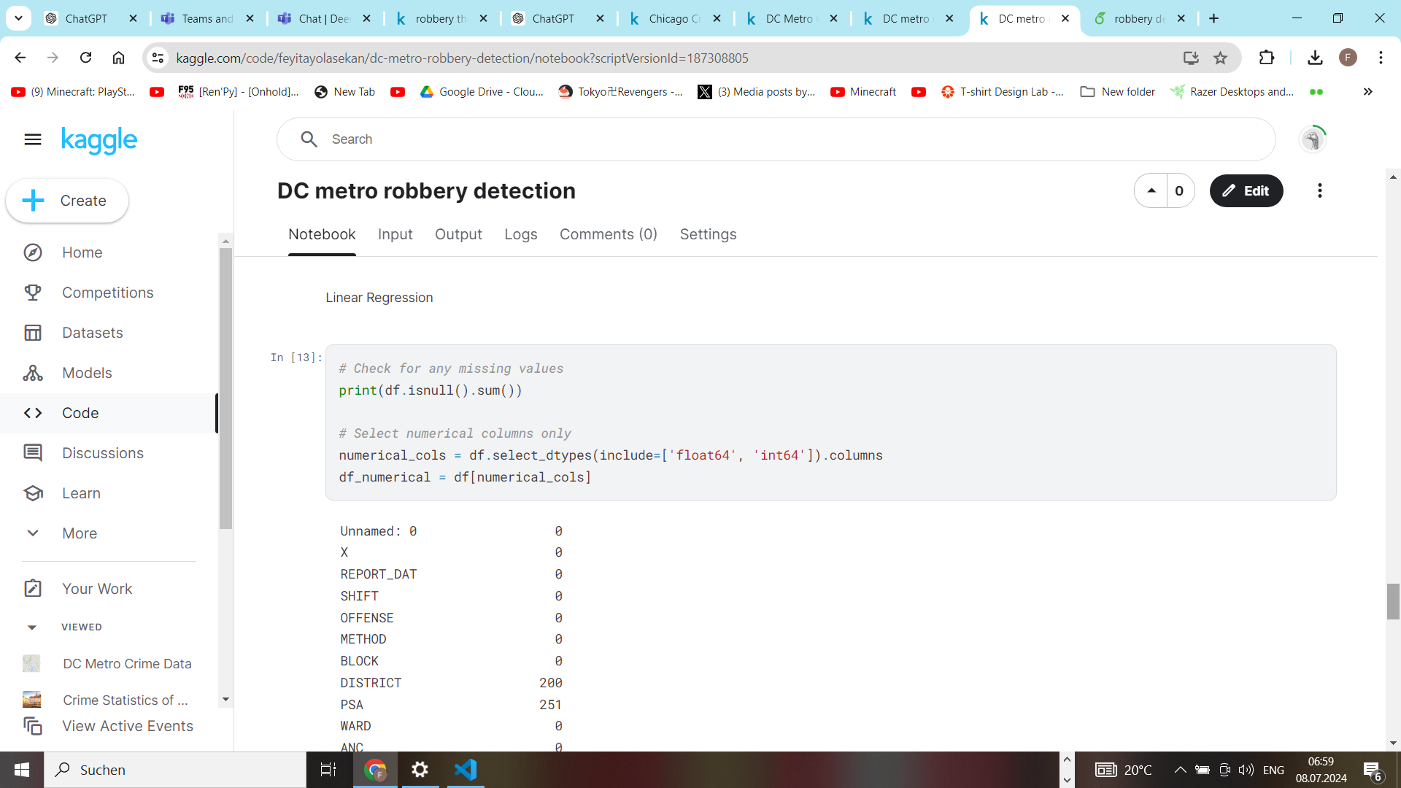

Slide 11
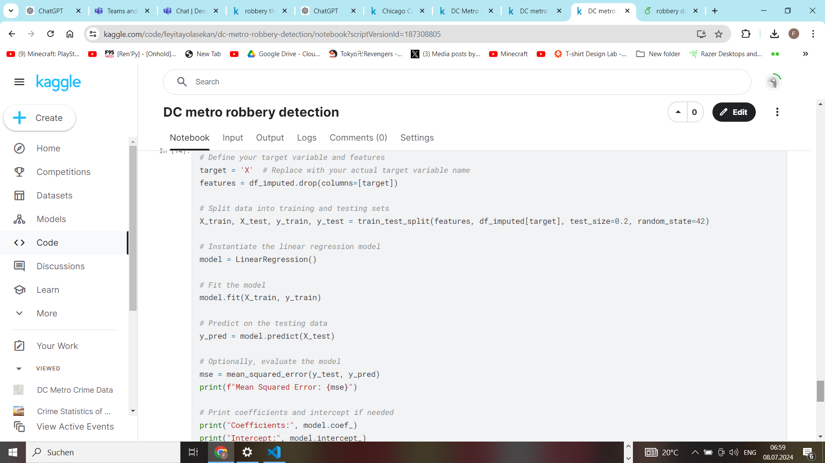

Slide 12
Conclusion
In conclusion, this dataset provides a comprehensive view of crime in the DC Metro area, though some columns have missing data that need addressing for more detailed analysis. The initial findings indicate that most crimes are non-violent and that there are discernible patterns in the temporal distribution of crimes. Future work should focus on filling the missing values, conducting deeper temporal analysis, and exploring the spatial distribution of crimes to identify hotspots. This will provide more granular insights into crime patterns and help in developing targeted crime prevention strategies.

Slide 13
Links and ending remarks
Thank you for listening and reading my project. I am really grateful for this. here are the links to my project documentation on kaggle and overleaf :
overleaf
https://www.overleaf.com/read/nwcwbxpnpnrd#ae8eb1
kaggle
https://www.kaggle.com/code/feyitayolasekan/dc-metro-robbery-detection

